Slide 1

Objectives
In this session, you will learn to:
  Measure performance-related data for processors
  Identify the hierarchy of memory
  Benchmark processor performance
Notes:
Initiate the discussion by asking the students how the hardware considerations can help in enhancing performance of an application.
Explain that using the available resources, such as processor and memory in an efficient manner can improve the performance of your application.
Also ask students what is hyper threading technology?
Hyper-Threading Technology enables multi-threaded software applications to execute threads in parallel. Threading was enabled in the software by splitting instructions into multiple streams so that multiple processors could act upon them. But Hyper-Threading Technology utilizes processor-level threading which offers more efficient use of processor resources.

Slide 2
Examining Processor Specifications
Processor:
  Computes the instructions in a program and calculates the result.
  Should be used optimally by the application.
  Performance also affects application performance.
  Performance should be measured to know how the processor is utilized.
Notes:
Ask students why it is necessary to understand the processor specifications to optimize performance of your application.
Explain in detail the processor specifications, such as processor speed, functional units, and process execution.
Ask them about the pipelining process and latency period of an instruction.

Slide 3
Identifying Processor Performance
Processors consists of functional units that execute specific instructions.
Different types of processors have different speed of executing instructions.
Before beginning to optimize the application performance, you need to:
  Identify processor speed
  Identify the execution process
  Identify the functional units of a processor
Notes:
Ask students why it is necessary to understand the processor specifications to optimize performance of your application.
Explain in detail the processor specifications, such as processor speed, functional units, and process execution.
Ask them about the pipelining process and latency period of an instruction.

Slide 4
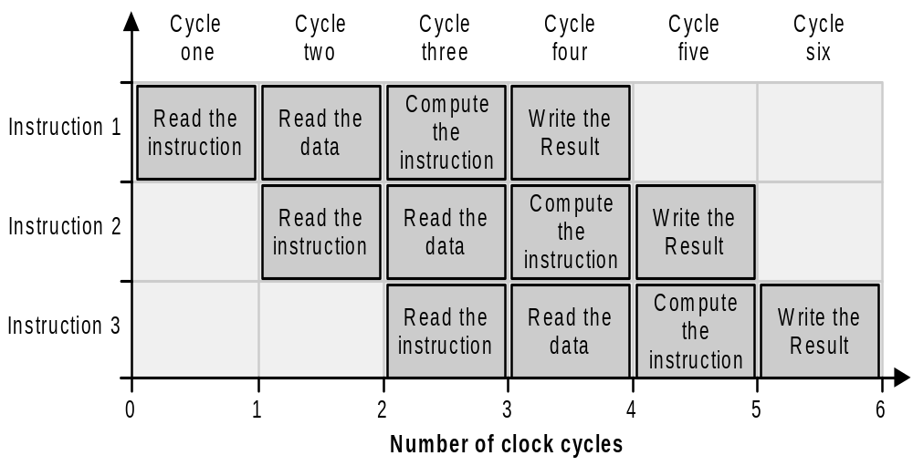
Identifying Processor Performance (Contd.)
Pipelining is an important concept used in high-performance computing.
Pipelining is shown in the following figure.
Notes:
In this slide and the next slide, explain the concept of pipelining.
Explain the different functional units of processor.
You can explain processor architecture using the following example:
Mobile Intel Celeron Processor for Embedded Computing is available at 1.2 GHz frequency. It has a 400 MHz processor system bus delivering 3.2 GB of data per second into and out of the processor. It uses the Hyper-pipelined technology. The functional units of the processor include two Arithmetic Logic Units and a floating-point unit. It consists of 128-bit floating-point registers an additional register for data movement. It supports 128-bit SIMD integer arithmetic operations and 128-bit SIMD double-precision floating-point operations. The Software Prefetch functionality of a Mobile Intel Celeron Processor anticipates the data needed by an application and pre-loads it.
Explain that to identify processor speed, you need to consider the latency period of an instruction and the length of instructions.
Ask students how identifying the different phases of processor and memory utilization can help to optimize the performance of your application.

Slide 5
Identifying Processor Performance (Contd.)
Pipelining has multiple stages.
Different parts of pipeline perform different jobs.
Some parts of the pipeline can be duplicated so that less work is done at each stage.
Pipelining has substantial impact on the performance of the application.

Slide 6
Identifying Processor Performance (Contd.)
A process consists of different phases of processor and memory utilization.
The sequence processes follow are:
  Phase 1: Memory burst
  Phase 2: CPU burst
  Phase 3: Memory burst
►
  Read the instruction to be executed
  Read the data from the memory
►
  During this time, the process is either running or waiting for the processor.
►
  During this time, the process is waiting for memory write operation

Slide 7
Identifying Processor Performance (Contd.)
Instructions for different applications are of diverse types.
Typically, each application will have multiple types of instructions.
Different parts of processor, called functional units, executes different types of instructions.
Functional units are of the following types:
  Memory operations
  Integer operations
  Floating-point operations

Slide 8
Measuring Processor Performance
Processor performance is measured in terms of the following parameters:
  Branch mispredictions
  Loads/Stores complete
  Throughput
  Turnaround time
  Instruction execution time
  Program execution time
  Waiting time
  Response time
  CPU utilization
  CPU efficiency
►
  It means that the branch executed is not the same as predicted by the processor.
  In such a case, there is an additional overhead in loading the data values for the branch not executed by the processor.
►
  It refers to the process of loading data from the memory and stores refer to writing data back to the memory per unit time.
►
  It refers to the number of processes that complete their execution per unit time.
►
  It refers to the amount of time to execute a particular process. It is also called execution time.
►
  It refers to the execution time for an instruction.
►
  It refers to thee execution time for a program.
  It is the sum total of the execution time for each instruction.
►
  It refers to the amount of time a process has been waiting in the ready queue.
►
  It refers to the amount of time taken to generate a response to a request.
  It refers to the fraction of time the CPU is processing instructions.
  The difference between CPU utilization and CPU efficiency is that CPU utilization is the fraction of time when the CPU is not idle while CPU efficiency is the amount of time when the CPU is computing instructions.
►
  It refers to the fraction of time a process is using the CPU.
►
Notes:
Explain the terms displayed on the slide with the help of animations.

Slide 9
Measuring Processor Performance (Contd.)
Some standard metrics to measure the processor performance are:
  Instructions retired
  Clock Cycles Per instruction Retired (CPI)
  Percentage of floating-point instructions
►
►
►
  CPI is the ratio of the number of clock cycles to the number of instructions retired.
  It is a measure of a processor's internal resource utilization. A high value indicates low resource utilization.
  This metric reports the number of instructions that are retired during program execution.
  When the execution of the instructions is complete, the processor does not require the instructions any longer.
  Thus, when the processor discards these instructions, they are said to be retired.
  This metric measures the percentage of retired floating-point instructions.
  A high percentage of floating-point instructions indicate that the program is using only a specific resource while other resources are idle.
Notes:
Ask students the standard metrics to measure performance of a processor.
Ask students what are Retired events?
Retired events refer to the events that occur due to instructions that are committed to the machine state. For example, when measuring Loads retired event, load occurring on a mispredicted path is not counted.
Explain in detail the Instructions Retired, CPI, and Percentage of floating –Point Instructions standard metrics.
Ask students what are Instructions Retired?
Instructions Retired are the number of instructions that are committed to the processor state or executed completely.
Instructions Retired standard metric can be used to view the number of instructions that are discarded during execution of program.
CPI refers to the ratio of the number of clock cycles to the number of instructions retired.
Percentage of Floating-Point Instructions measures the percentage of retired floating-point instructions.

Slide 10
Just a minute
How can you measure processor performance?
Answer:
  Processor performance is measured in terms of the following parameters:
    Branch mispredictions
    Loads/Stores complete
    Throughput
    Turnaround time
    Instruction execution time
    Program execution time
    Waiting time
    Response time
    CPU utilization
    CPU efficiency

Slide 11
Examining Memory Specifications
The performance of a processor also depends on how fast data can be read from and written to the main memory.
Memory speed is considerably slower than processor speed.
The difference in the speeds of the processor and the memory affects application performance.
In spite of computers with better processing power, the impact of processor speed on the performance of applications is not substantial.
The solution is to minimize the mismatch between the processor and memory speeds.
To optimize application performance, it is important to understand the memory hierarchy on a computer and the performance of different components of the memory.
Notes:
Ask students how understanding the memory specifications can enable you to enhance the performance of your application.
Explain that the computer memory is a combination of various types of memory and that to get the optimal performance you need to understand the memory hierarchy.

Slide 12
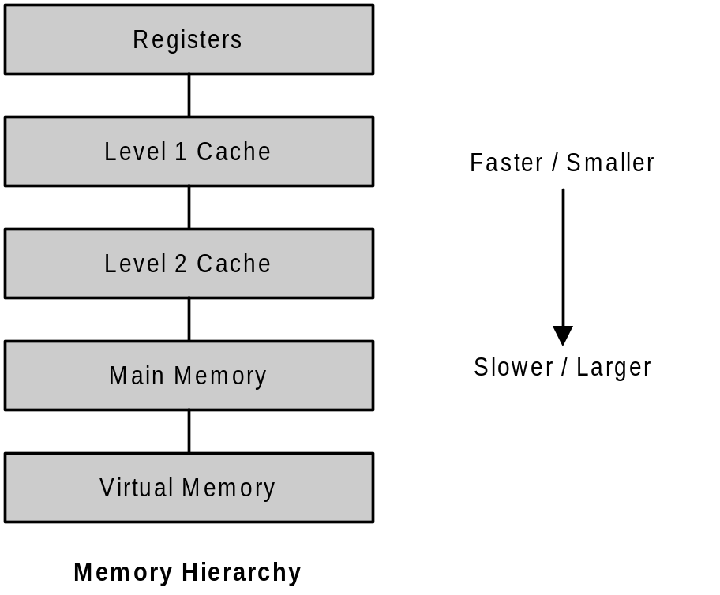
Understanding the Memory Hierarchy
The following figure shows the memory hierarchy on a computer system.
►
  Registers speed up the execution of instructions by providing fast access to intermediate values computed during a calculation.
►
  This is the lowest level of cache memory, which is faster and smaller
►
  It is larger in size but slower than the L1 cache
►
  It is slower and cheaper than cache memory but faster and more expensive than virtual memory.
  It is measured in megabytes.
  The processor cannot directly access virtual memory.
  When data referenced by a virtual address is requested, the virtual address is translated to a main memory address
►
Notes:
Explain the different levels of memory hierarchy as displayed on the slide.
Registers enable fast execution of instructions as they provide fast access to values computed during calculation.
Explain the multiple levels of cache memory
Main memory is the primary storage of computer and is directly connected to the processor.
Explain the process of paging in virtual memory.

Slide 13
Just a minute
What is the purpose of cache memory?
Answer:
  Cache memory reduces the mismatch in the speeds of the processor and the main memory.

Slide 14
Understanding Memory Performance
When executing an instruction, the processor waits for the data to be fetched from the memory.
The processor cannot execute any other instruction while waiting because the previous instructions are loaded into registers.
To achieve optimal performance, you must store the data as near as possible to the processor so that the processor is not idle.
This helps to reduce the time utilized for memory access and improve processor utilization.
Notes:
Ask how mismatch in memory and processor speed can decrease the performance of an application.
Ask how you can calculate the time taken for memory access.

Slide 15
Understanding Memory Performance (Contd.)
You can calculate the time taken for memory access by knowing the hit and miss ratios.
  The hit ratio is the number of times required data is available to the total number of times data is requested from memory.
  The miss ratio is the number of times data is not found to the total number of times data is requested from memory.
Notes:
Explain the Hit and Miss ratios as given in the slide.
Ask the following question:
If the data is requested 78 times and it is found in the cache 56 times, and for all the other times it has to be loaded from the main memory. What is the cache miss ratio?
Ans: The miss ratio is 78-56/78 = 0.28

Slide 16
Understanding Memory Performance (Contd.)
To improve the performance of memory, you should ensure that the data that the processor requested is at the nearest location.
For this, you must be able to predict which data the processor will reference.
This can be accomplished using the principle of locality of reference.
The two types of locality of reference are:
  Spatial locality
  Temporal locality
►
  Memory locations near each other are usually used together.
  If a program accesses a particular memory location, it might soon access a nearby memory location.
  This location is called spatial locality.
►
  If a program accesses a particular memory location, it might soon access the same memory location. This location is called temporal locality.
Notes:
Ask students the reason for data that the processor requested to be at the nearest location.
Tell the students that for this you should be able to predict the data that the processor will reference.
Explain the different types locality of references mentioned in the slide.
Ask what applications exhibit spatial locality

Slide 17
Analyzing Issues Affecting Memory Performance
Some of the issues that affect memory performance are:
  Cache compulsory loads
  Cache capacity loads
  Cache conflict loads
  Cache efficiency
  Data alignment
  Software prefetch
►
  When the required data is not found in the cache, it has to be loaded in the cache. This is known as a cache compulsory load.
  This occurs when the data is loaded for the first time in the cache.
►
  At times, the cache has to remove recently used data to accommodate other data requested by the processor.
  This is because, the capacity of the cache is limited.
►
  Cache conflict loads occur if the processor accesses five or more units of data that use the same row.
  You can avoid cache conflict loads by changing memory alignment, using registers for holding data, or using algorithms that use fewer regions of memory.
►
  Cache efficiency is the ratio of data loaded into the cache to the data used.
►
  Data alignment is the organization of data in memory.
  Effective data alignment can improve cache efficiency.
►
  Software prefetch enables a processor to load a specific location of memory before it is required for processing.
  As a result, the time taken for reads and writes is reduced by the amount of time that is saved while the data is being loaded in the cache.
Notes:
Ask students the reason for data that the processor requested to be at the nearest location.
Explain the various performance issues that affect the memory performance.
While explaining cache conflict loads, explain that the data in the cache is organized in rows. If multiple data (five or more) from a single row is accessed by different processes at the same time, a cache conflict load occurs.

Slide 18
Benchmarking
A benchmark is a standard that is used for comparison.
In terms of application performance, you can consider processor and memory benchmarks.
To arrive at a specific benchmark, you can use tests to compare the performance of hardware and software running a specified workload.
If you use graphic applications, a benchmark that tests graphics speed might be useful.
Notes:
Ask students the reason to use benchmark for optimal performance of applications.
Give an example that if you use graphic applications, benchmark that test graphics can be useful.

Slide 19
Benchmarking (Contd.)
The different types of benchmarks are:
  Single stream benchmarks
  Throughput benchmarks
  Interactive benchmarks
►
  Single stream benchmarks measure the time taken by the computer to execute a collection of programs.
►
  Throughput benchmarks benchmark processor performance for several jobs or a mix of codes running simultaneously.
►
  Interactive benchmarks benchmark the components of a computer such as input/output system, operating system, and networks.
Notes:
Ask students the different types of benchmarks used.
Explain the various types of benchmarks.
Explain that single stream benchmarks measures the time that the computers take to execute a collection of programs.

Slide 20
Just a minute
What are various benchmarks for measuring processor performance?
Answer:
  The different types of benchmarks are:
    Single stream benchmarks
    Throughput benchmarks
    Interactive benchmarks

Slide 21
Reading CPU Cycles to Measure Processor Performance
The benchmarks for processor performance are:
  Read Time Stamp Counter (RDTSC)
  Million Instructions Per Second (MIPS)
  Million Floating Point Multiply Operations (MFLOPS)
Notes:
Ask the different types of benchmarks used for processor performance.
Explain in detail the benchmarks for processor performance.
Explain that MIPS or Million Instructions Per Second. It is a processor benchmark and refers to the low-level machine code instructions that a processor can execute in one second.
Also, explain that MFLOPS refers to how many million floating-point multiply operations that can be performed per second.

Slide 22
Summary
In this session, you learned that:
  Application performance is closely related to hardware resources, such as processors and memory.
  Processor speed is measured in clock cycles per second. This is an indication of the number of instructions executed in unit time.
  Pipelining is an approach used for high-performance computing to obtain maximum processor output.
  The execution process of an instruction consists of CPU and memory bursts.
  A processor contains different functional units for executing memory, integers, and floating-point instructions.

Slide 23
Summary (Contd.)
  Processor performance can be measured in terms of branch mispredictions, loads/stores complete, throughput, turnaround time, instruction execution time, program execution time, waiting time, response time, CPU utilization, and CPU efficiency.
  Computer memory consists of registers, cache memory, main memory, and virtual memory.
  The performance of memory depends on the speed of the memory.
  Cache compulsory loads, cache capacity loads, cache conflict loads, data alignment, and the software prefetch capability affect memory performance.
  Performance benchmarking is the process of defining standards for application performance in terms of processors and memory.

